Slide 1

World War I
By: B Hergott
R.C.S.S. History

Slide 2
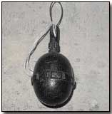
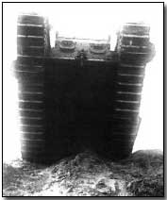
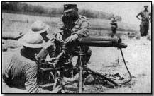
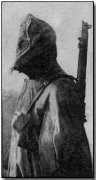
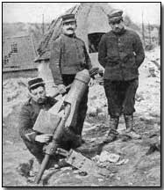
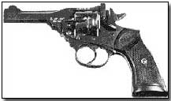
World War I Weapons

Slide 3
KEY WEAPONS OF WWI
Gas
Tanks
Machine Guns
Rifles and bayonets
Grenades
Artillery
Submarines
Flame Throwers
Airplanes and zeppelins

Slide 4
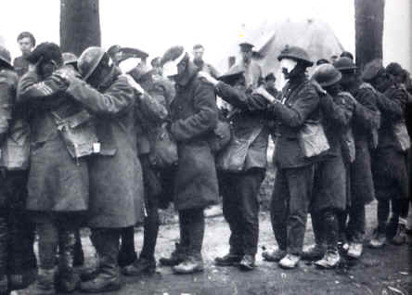
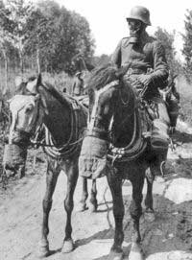
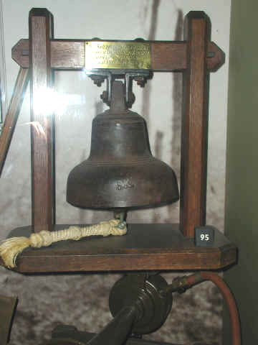
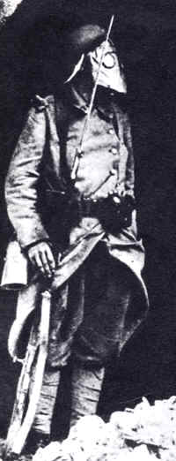
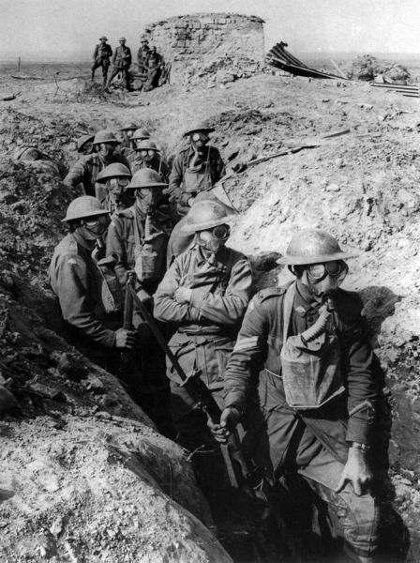
A Deadly Weapon
GAS
As World War I went on, poison gas was used more often everyday.
Introduced by the German army in 1915 at the Battle of Ypres, the gas could be shot out of a special gun or be bombed from planes.
The gas was made up of many different chemicals, including Chlorine and Phosgene and (Mustard Gas). Anyone breathing it could become very sick or even be killed instantly.
German warning bell for gas.
Australian infantry with gas masks, Ypres, 1917.

Slide 5
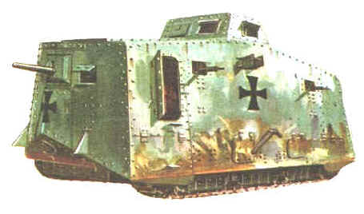
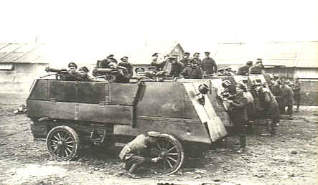
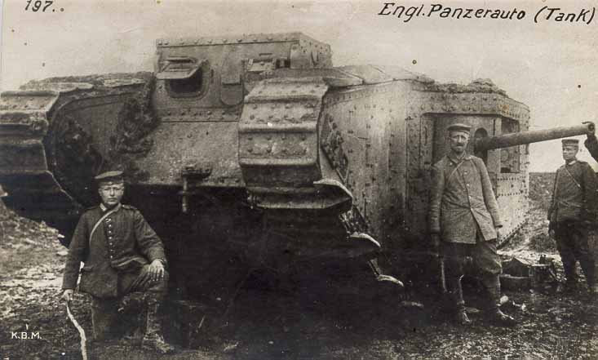
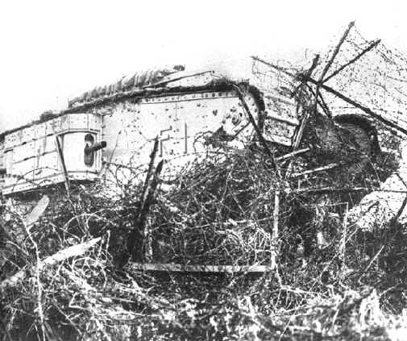
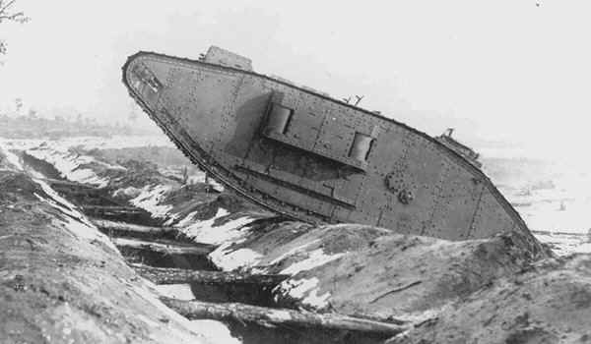
The Tank
German Schwerer Kampfwagen A7V
idea of the tank inspired by farming vehicles that used caterpillar tracks.
Armored vehicles were already made, but they weren’t able to cross trenches.
The first tank was used by the British at the Battle of Somme. The name tank came when the British tried to hide the armored cars in crates marked as “Tanks”.
Maximum speed 3 mph.
Gunners and drivers of a Canadian Army motor machine gun detachment cleaning their weapons and vehicles after a successful operation in the Somme area.
Breaking through
Germans with a captured British tank; the tracks at the front are higher in order to climb obstacles, and the side-mounted guns keep the centre of gravity low.
Climbing and crossing

Slide 6
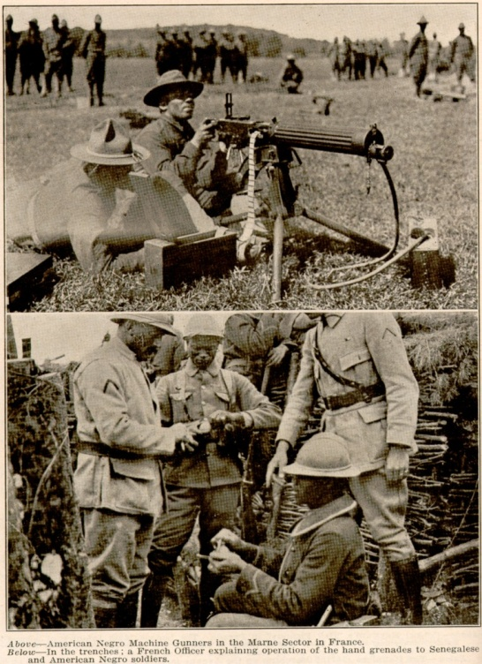
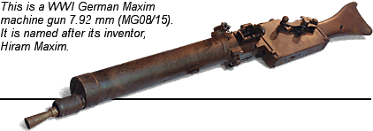
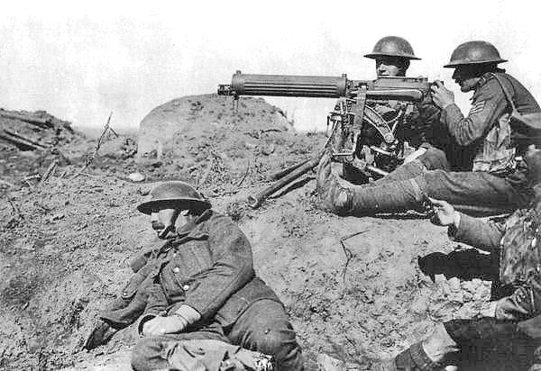
The Machine Gun
During World War I most of the fighting happened in the trenches. The armies dug deep trenches into the ground and faced each other and used machine guns to fire 300 to 350 rounds per minute and required 4-6 men to operate them.
"The enemy started to advance in mass down the railway cutting, about 800 yards off, and Maurice Dease fired his two machine-guns into them and absolutely mowed them down. I should judge without exaggeration that he killed at least 500 in two minutes. The whole cutting was full of bodies and this cheered us all up." (Tower 10)
The machine gun was one of the decisive technologies during World War I. Picture: British Vickers machine gun crew on the Western Front.

Slide 7
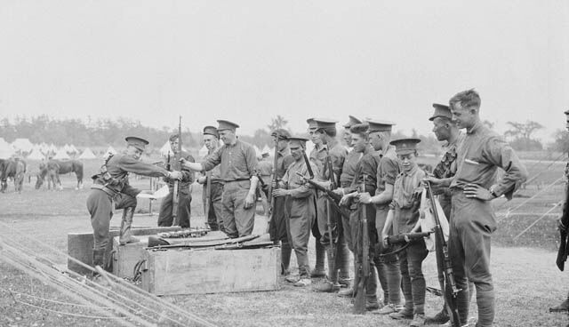
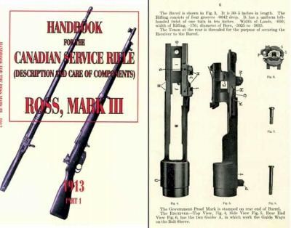
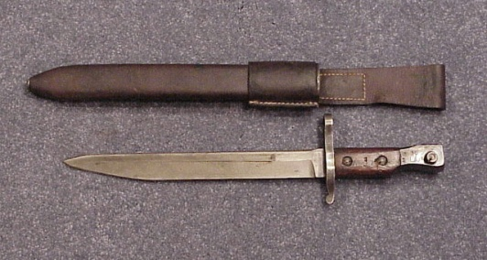
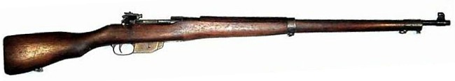
A Canadian Failure: The Ross Rifle
The Ross rifle was the principal weapon of the Canadian corps in Europe during WWI, and it turned out as a complete failure. The Ross Mark III rifle was too sensitive for dirt and fouling and overheated easily during intense battles. The Ross was dropped by the Can. Army in 1917 and replaced with reliable British Lee Enfield Rifle
Ross Rifle, Mark III
bayonet

Slide 8
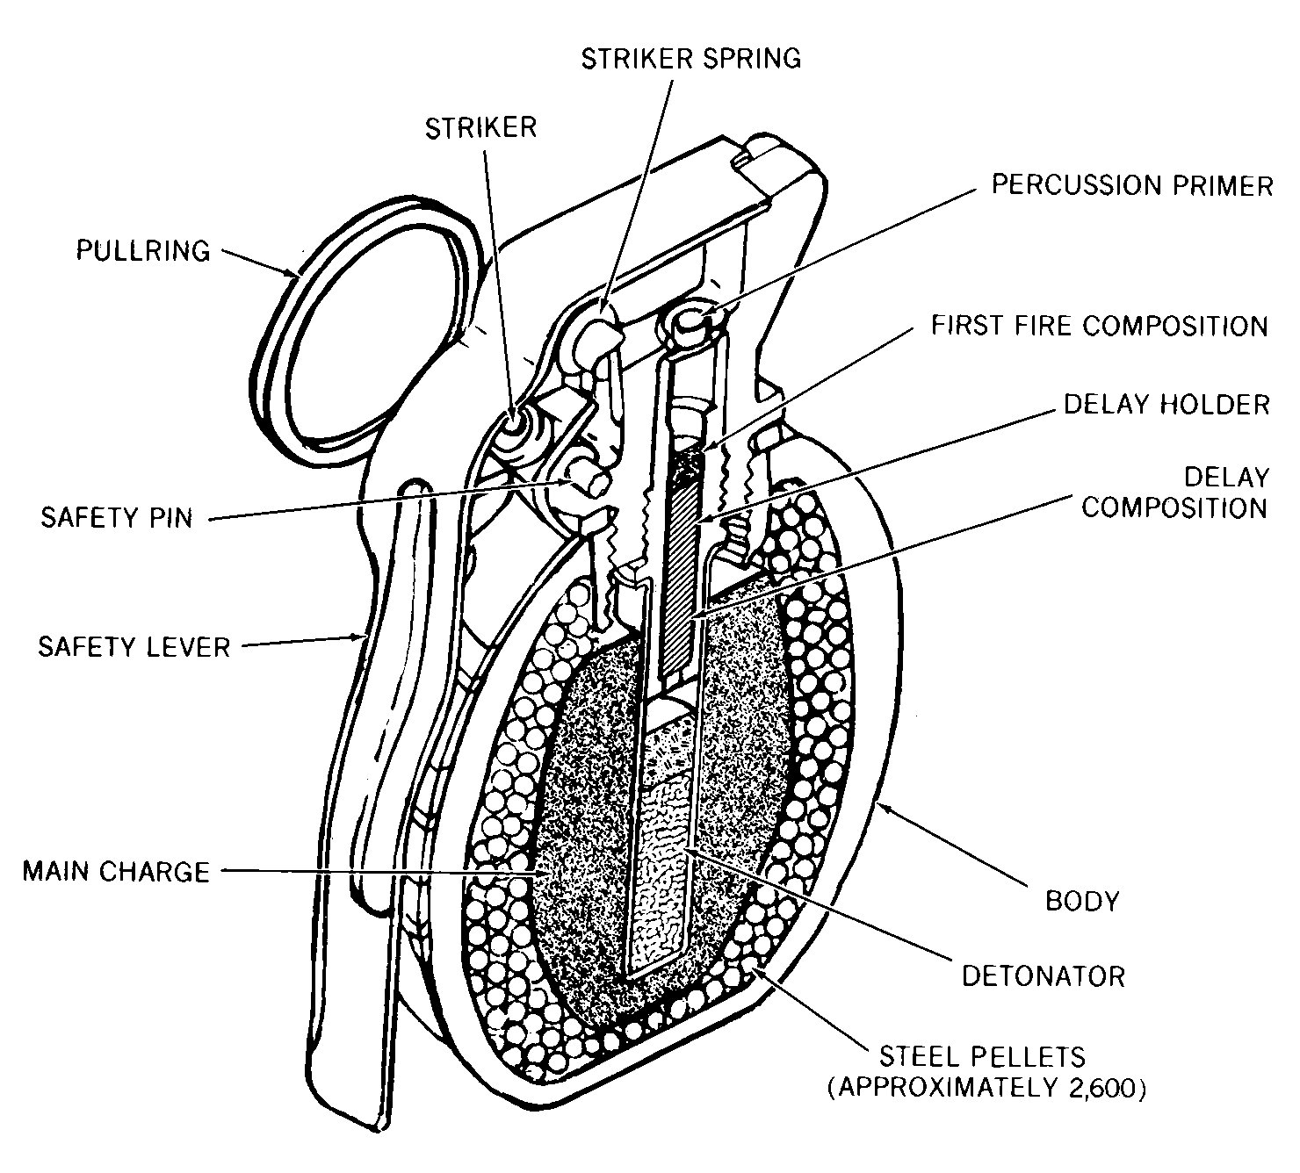
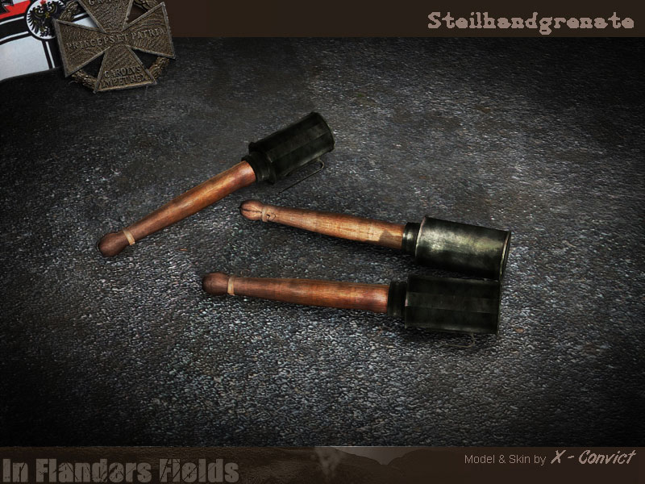
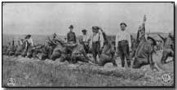
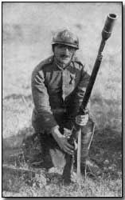
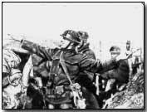
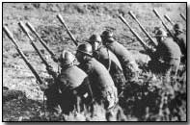
GRENADES
Mills Bomb invented 1915 by British; 75 million were used during World War One

Slide 9
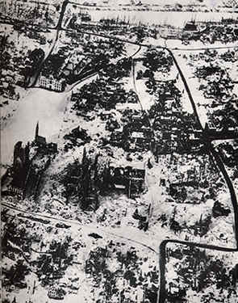
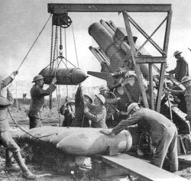
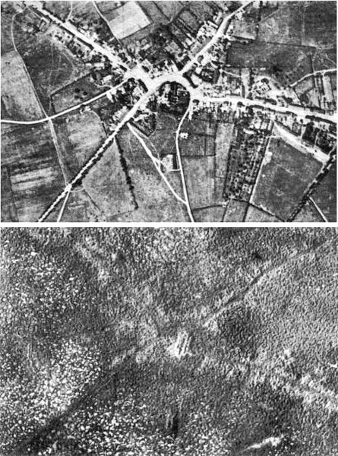
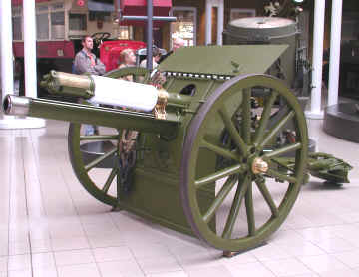
ARTILLERY
Loading a 15-inch howitzer
Passchendaele village, before and after the 3rd Battle of Ypres.
The devastation of Ypres - barely a building was left undamaged by shell bombardment
In August 1914, the British Army had 1,226 of the 18 pounders. Such was its reliability, that by the end of the war, the army had 9,424 in service
The 18 pounder could fire shells of high explosives of between 4.6 kg and 8.4 kg. The 18 pounder had a range of 5,966 meters

Slide 10
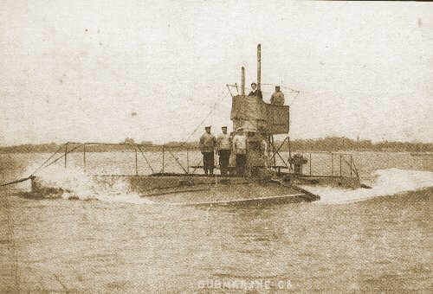
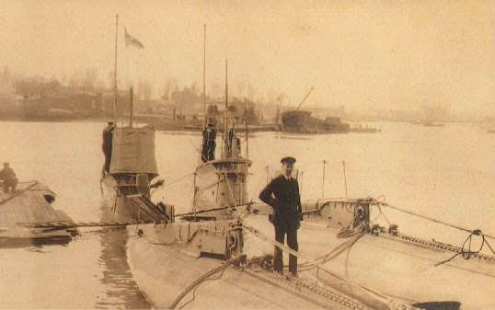
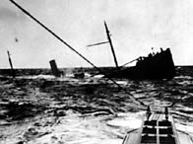
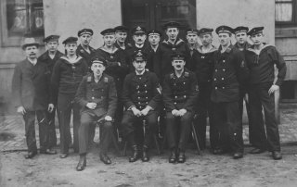

Submarines
The submarines were not considered much of a threat at the beginning of World War I, but it wasn’t long until they became a major threat for both sides. A submarine is a ship that travels under water. Germany’s were called U-Boats. Most submarines are used in the war to attack enemy ships with torpedoes.

Slide 11
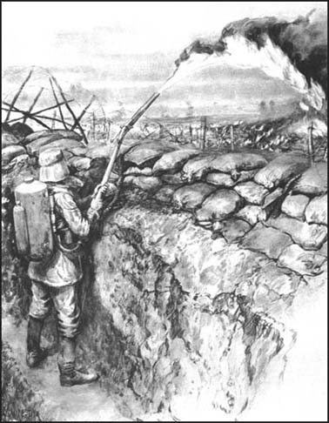
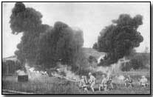
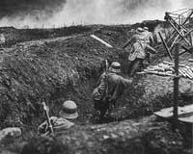
The Flamethrower
The Flamethrower, which brought horror to the French and British soldiers during WWI, was first used by the German army. The flame-thrower used pressurized air, carbon dioxide or nitrogen to force oil through a nozzle. Ignited by a small charge, the oil became a jet of flame.
The basic idea of the flamethrower was to spread flames throughout the battlefield or trench to terminate any enemy infantry.

Slide 12
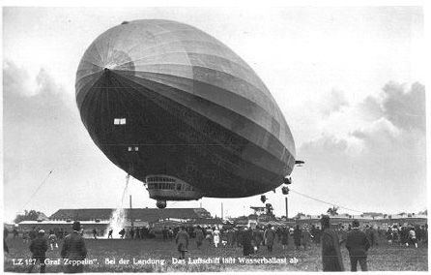
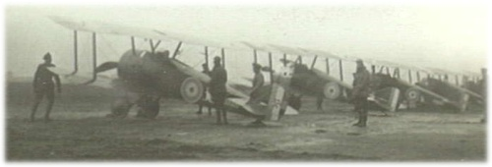
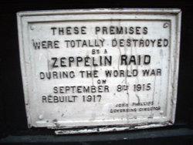
World War I
Airplanes and Pilots
"We do not consider that aeroplanes will be of any possible use for war purposes" — Richard Haldane British Secretary of War, 1910
88 Zeppelins were built during the war. Over 60 were lost, roughly evenly divided between accident and enemy action. Fifty-one raids were undertaken, in which 5,806 bombs were dropped, killing 557 people and injuring 1,358.

Slide 13
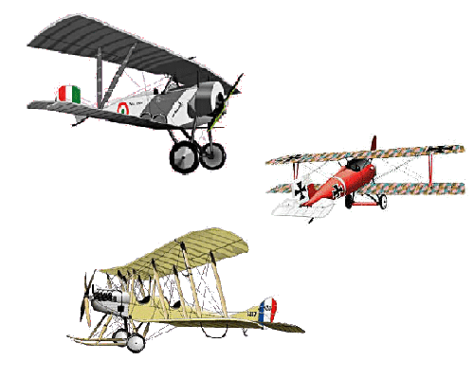
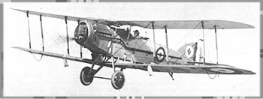
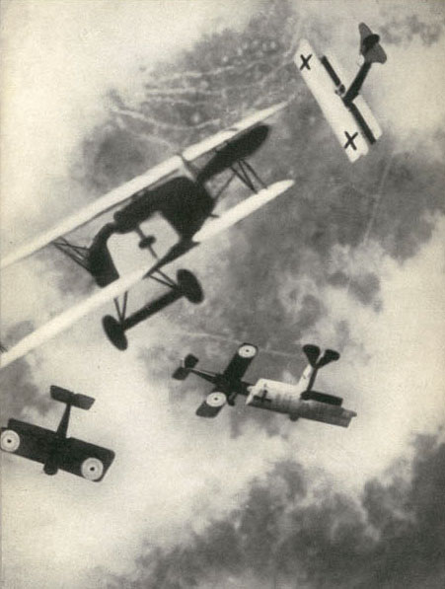
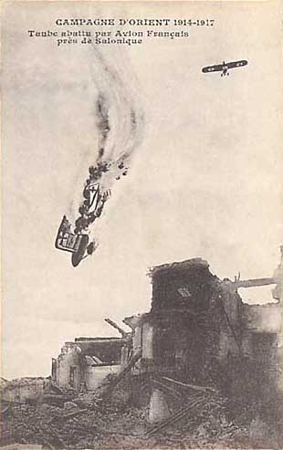
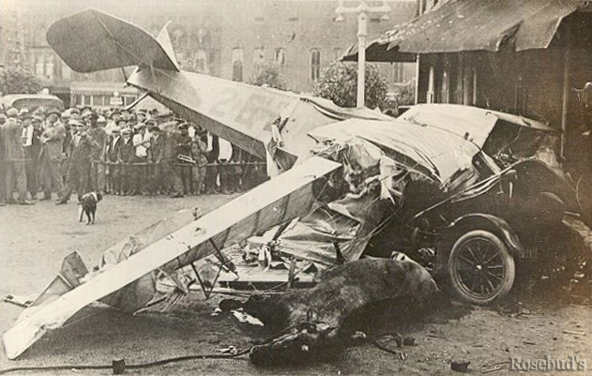
World War I Planes
WWI was the first war to have airplanes used as weapons. This changed the way wars were fought.
The planes were quite small and were made from wood and canvas and thus were quite fragile and crashed easily
Planes became fighter aircraft armed with machine guns and bombs; they were also used for reconnaissance work
Pilots known as “aces” would often engage enemy aircraft in the air, in “dogfights”
Bristol fighter bi-plane, 1917 (British)

Slide 14
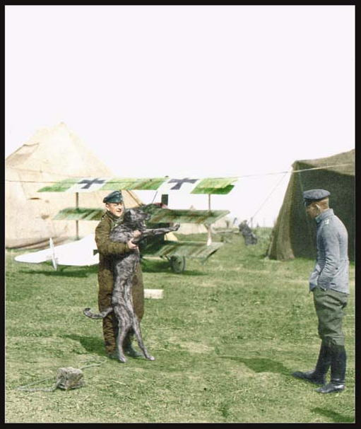
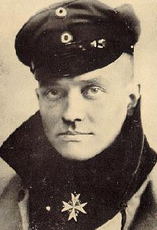

The Red Baron
Manfred von Richthoven, known as “The Red Baron” was an elite German fighter pilot famous for his ability in dogfights; he was eventually shot down and killed by a Canadian ace fighter.
The Red Baron was famous for the Fokker Tri-plane that he flew with great success.

Slide 15


Canadian Flying Ace: Billy Bishop
Billy Bishop as a cadet, ca. 1914 – age 20
Here is Billy Bishop "a man incapable of fear" - according to one American ace - and a Nieuport 17
Bishop totaled 47 “kills” during WWI and earned a Victoria Cross medal for bravery

Slide 16
Resources
http://www.firstworldwar.com/
http://www.pbs.org/greatwar/timeline/
http://www.eyewitnesstohistory.com/w1frm.htm
http://www.firstworldwar.com/timeline/
Medals [Online images] available at http://www.nationalarchives.gov.uk/documentsonline/medals.asp
"World War One." World Book. ed. 1989. Parenthetical Within Text (World War One 454-469)
Images and Videos from Multimedia Project Kit Resource CD
Microsoft Clipart Online
Flamethrower, gasmask, gun submarine, and tank, [online images] available at http://www.firstworldwar.com/weaponry/machineguns.htm
Bi-planes [online images] available at
www:century-of-flightsfreeola.com

